Slide 1
Demystifying the CISSP with AI
Jerry Looney
Notes:
Introduce Myself
20 years in IT
Career started in Tokyo as a systems engineer, followed by London followed by a free flight back home for a job interview - 12 years later , a redundancy offer at VMware tied up nicely with my mid life crisis and my family and I spent several months in Tokyo reconnecting with family and enjoying time together

Slide 2
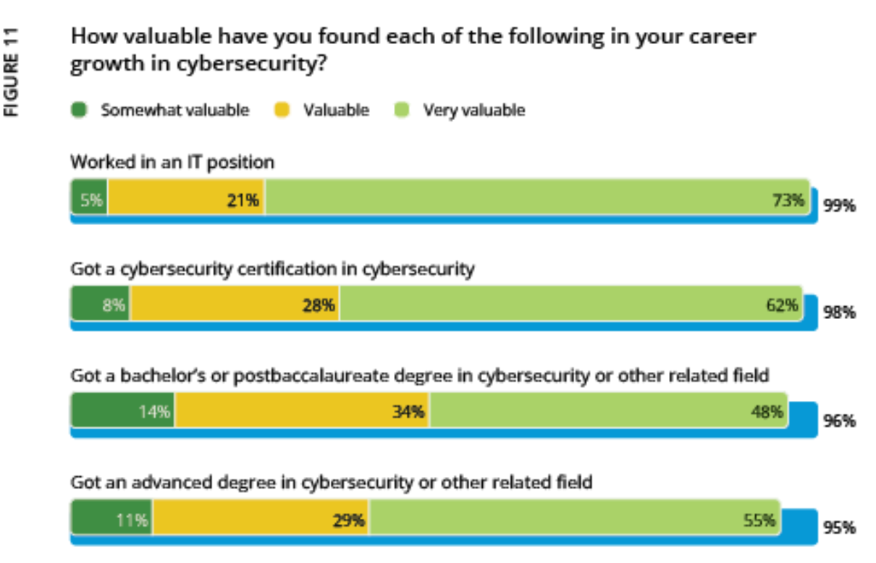
Why the CISSP?
2024 ISC2 Cybersecurity Workforce Study:
Certified Information Systems Security Professional
Demonstrates Cybersecurity Capability
Offers a mile wide, inch deep taste of potential Cybersecurity Careers
It is comparable to a masters degree standard (L7 RQF UK)
Notes:
Its a gold standard and substantial . With the state of the job market, ample time to achieve it.

Slide 3
The magic of Certification Why Certify?
Certificates can sometimes act as a HR filter either as a keyword or a requirement, unfairly excluding you from the review pile
The vast majority of employers consider it a leading predictor of success once employed.
Personally, after taking a nice break after redundancy to spend time with family, Its an excellent way to keep skills rust free and provides a PR friendly answer for the gap in employment :)
Notes:
I have an expired CCNA, it was a prerequisite for a role in London. I never used any of the skills on that job - it was purely a filter for candidates .

Slide 4
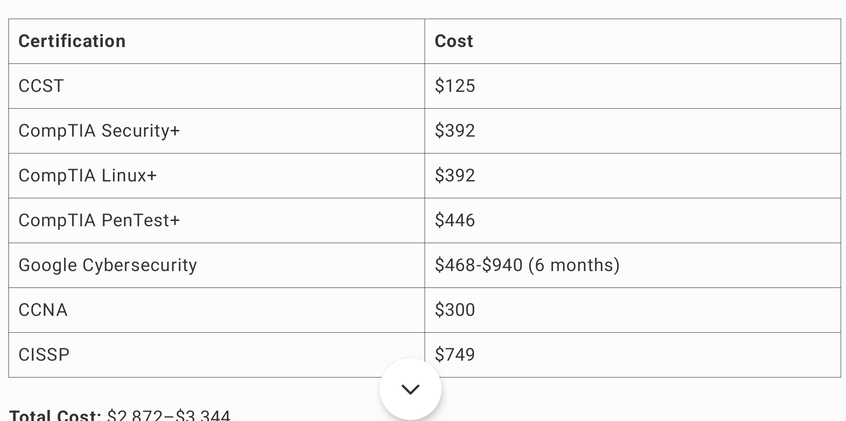
Shock Horror : Certifications cost Money
Total Cost Range: $2,872
This assumes no retakes or additional training materials.
Costs for certifications like Google Cybersecurity depend on the time taken to complete, as it’s billed monthly through Coursera.
New goal : Do it as cheaply as I can.
Notes:
After years of companies paying for certifications, I was a little spoilt and the cost of certification can quickly mount up.
Let's get it done as cheaply as I can.

Slide 5
Free/Low-Cost Learning Resources
Cheap:
Beta Exams – Try out new exams like Linux+ while they’re discounted or free. XK1-006 - try it for $50 , available until 2025-01-30. (GA exam - $333)
Vibes & Scribes – You can order in 2nd hand titles.
Free:
Free Trials: Coursera / Audible
YouTube – Access diverse, free educational content.
Fetchcourses.ie - worth its own slide!
Notes:
Cheap is good, free is better. Beta Exams are excellent opportunities to save a few pennies - you may wait longer for the results but its the same outcome, just friendlier on the wallet.
I have a CISSP guide here I got from Vibes&Scribes and its free to a good home. Cheap is good , free is better.

Slide 6
The brilliance of Fetch & Solas
Fetch courses saved me over €1,000 in Exam Costs alone!
Available Today: Pentest+, Security+, Cysa+, CCNA, CASP+, Linux+
Important:Availability and content may vary; some courses are seasonal, and eligibility criteria apply.
Opportunities Beyond IT:Explore foundational courses in various skill sets to discover new interests or career paths, like project management.
Most courses provide ebooks, video tutorials, and practice quizzes to enhance learning.
Fetchcourses.ie & ecollege.ie
Notes:
Government funded schemes that I had little to no awareness of when employed.
Fantastic resources to complement other options such as springboard etc.
Access to an ebook platform which if you are a book learner is invaluable. I devoured 3-4 books on the CISSP .
Free exam vouchers but you need proof of work - 90% 3 tests in a row on measure up.

Slide 7
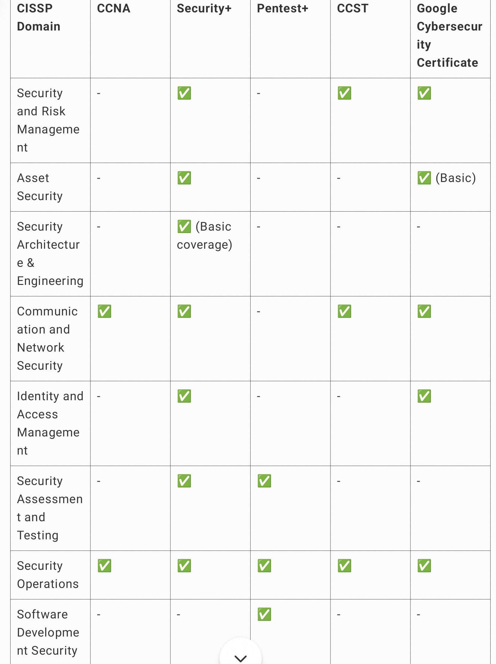
How did I build my pathway?
I uploaded my CV to Chatgpt , said I lived in a city with several cybersecurity Companies and wanted to take a few certificates to cover my gaps.
CISSP came up quite frequently as a gold standard certificate to acquire.
I asked chatgpt to map the CISSP domains to the other recommended certifications.
Notes:
I uploaded my CV to Chatgpt and asked it to dissect it and suggest skills to improve or grow considering the cybersecurity ecosystem developing in cork.

Slide 8
Content free with a Coursera trial
Expensive Exam , but generally insurance offers (2 attempts for 900 euro or so)
Free on Fetchcourses.ie
Google Cyber Cert
Security+
Pentest+
CCNA CCST
CISSP
Free on Fetchcourses.ie - course and exam voucher
Free on Fetchcourses.ie
Notes:
Google certificate on Coursera is well produced and engaging . It covered similar material to the security+ and was watchable - highly recommended.

Slide 9
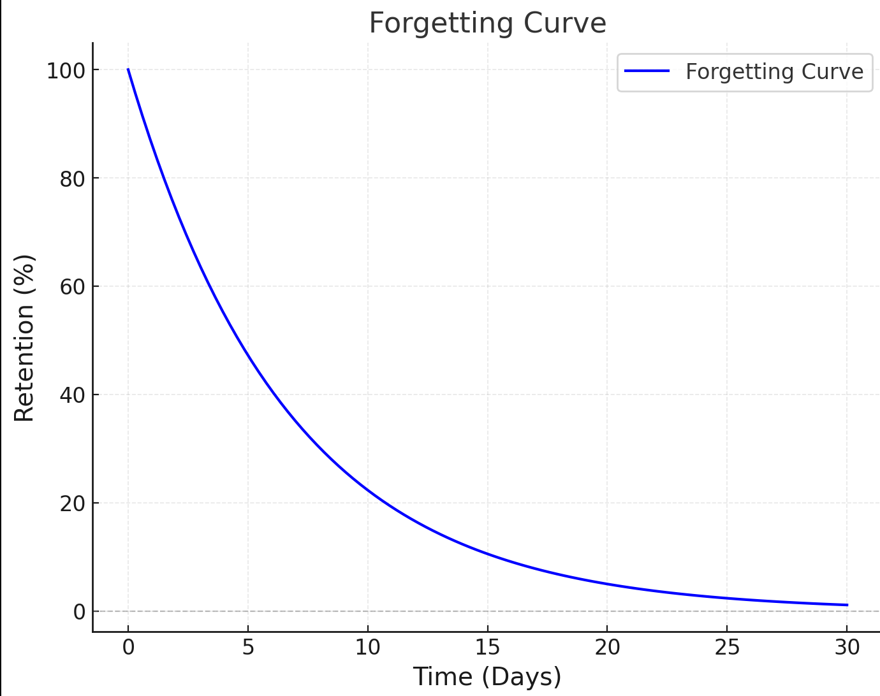
The Forgetting Curve
Knowledge decays over time.
Passing several certificates in a short time period enforces milestones and cumulative learning where each cert builds on the last
Repetition of foundational knowledge and going a little deeper in some domains builds confidence and ensures the knowledge sets.

Slide 10
Key ways I leveraged AI
It helped me break down the exam into manageable bite size accomplishments
It constructed a study plan to learn and revise for the exam
It highlighted my gaps and blind spots with CV analysis and Quizzes.
It helped me with the endorsement process.

Slide 11
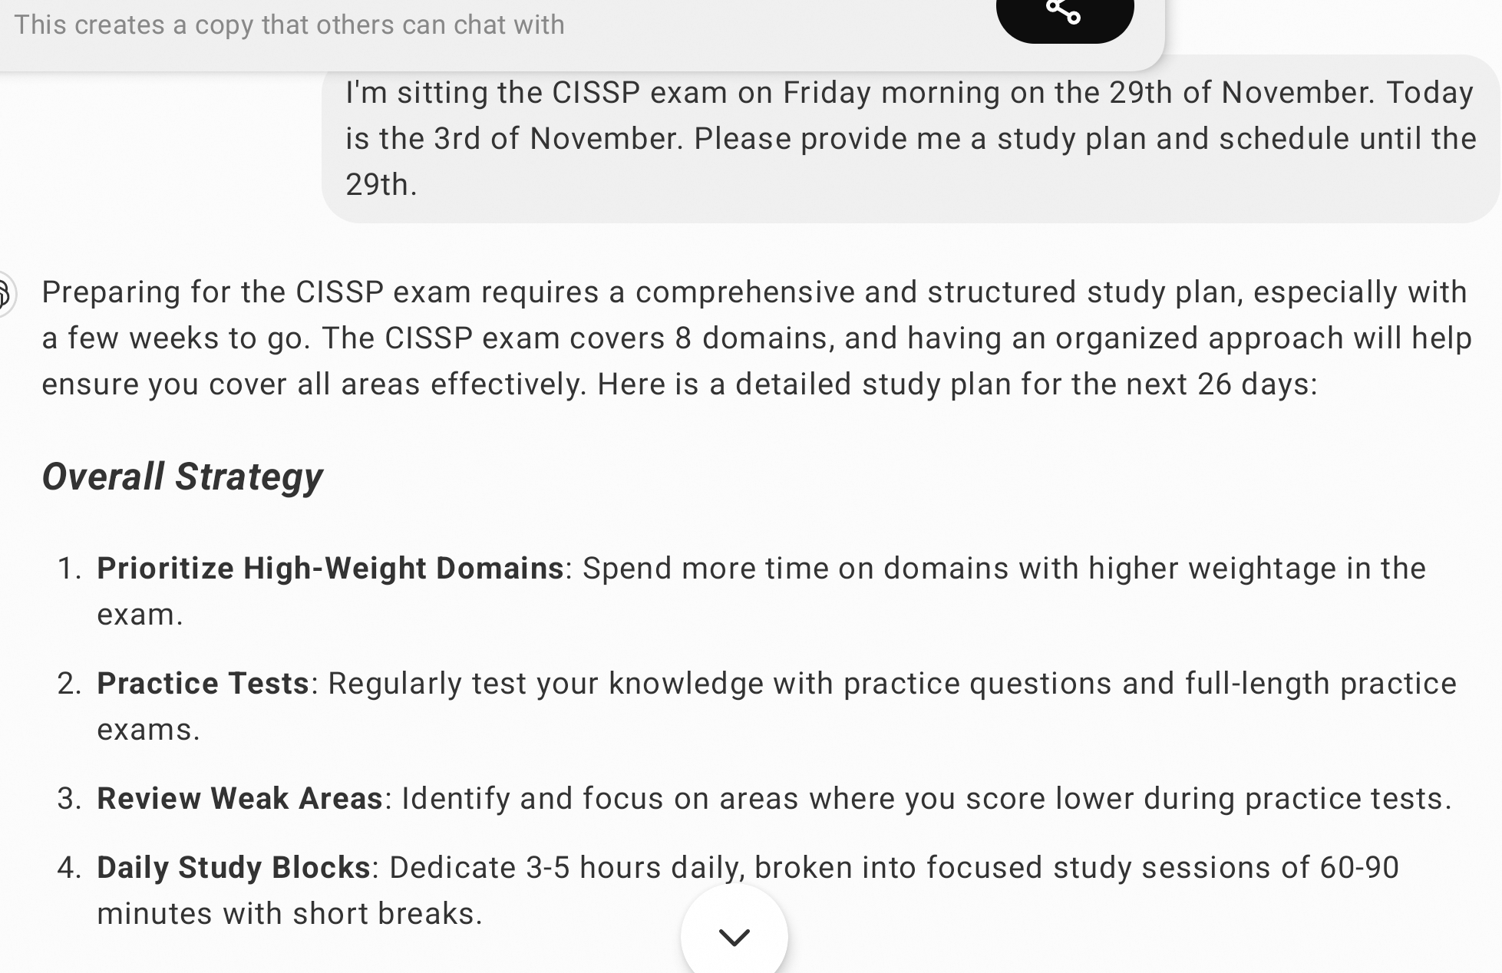
Chat-GPT Study Plan
After completing all the recommended certificates for the sub-domains, I booked the exam and asked AI to build me a study plan

Slide 12
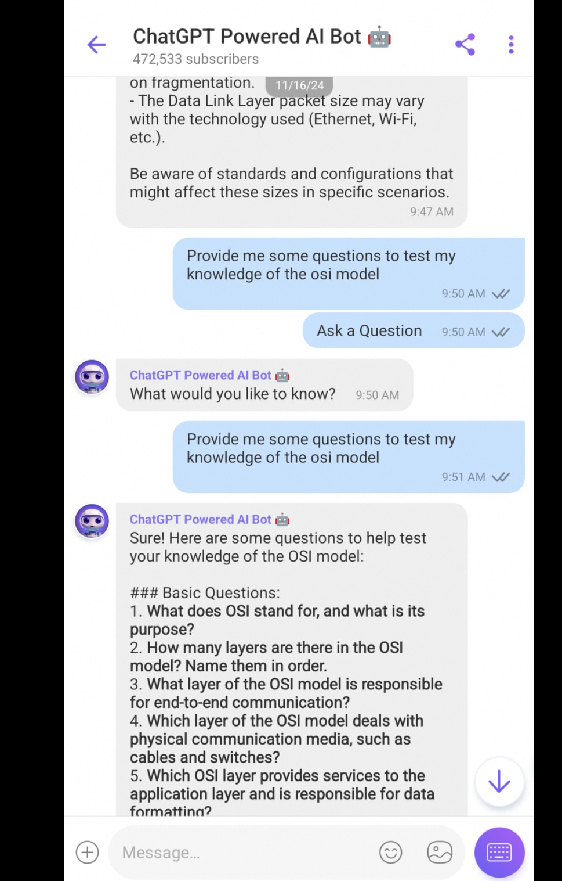
Study on the Plane
Life happens and I took time off for a family trip - On the way back , guilt set in and I studied. Air France offers free messaging on flights . Viber has an AI bot . I quizzed myself in air .
Notes:
Free wifi for messages so i had a play and quizzed myself on parts of the CISSP exam.

Slide 13
The exam & some helpful tips
Computerized Adaptive Testing (CAT) - It adapts, constantly assessing your ability - (spend time on your first 10 questions)
You cannot go back . There is no option to review your answer after it is submitted
You need to think like you are making a decision for the business as a whole, not the coolest tech or your department
There is often 4 answers to a question that are all reasonable answers, deconstruct each - focus on the questions language - most, best, least, always. Eliminate and Evaluate.
You will be applying your own judgement.
Due to the nature of the CAT, you will not be able to figure out if you are passing, just keep on answering questions.
Notes:
The algorithm finds your weak spot and focuses on it.
Unique parts of the test - you cant go back and you dont get a score on the screen
Careful consideration of question language helps
Spend time on your first 10 questions

Slide 14
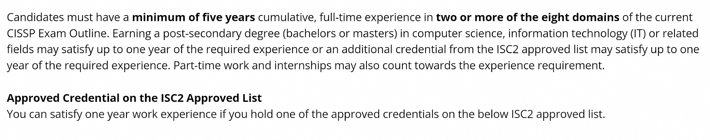
Endorsement with the help of AI
You need to provide proof of 5 years work experience in 2 of the 8 domains.
You can get a waiver of a year with a relevant qualification
I provided my CV to AI and got it to break down my experience by domain.
The experience requirement reduces to 4 years with a relevant degree or certification (Security+ qualifies)

Slide 15
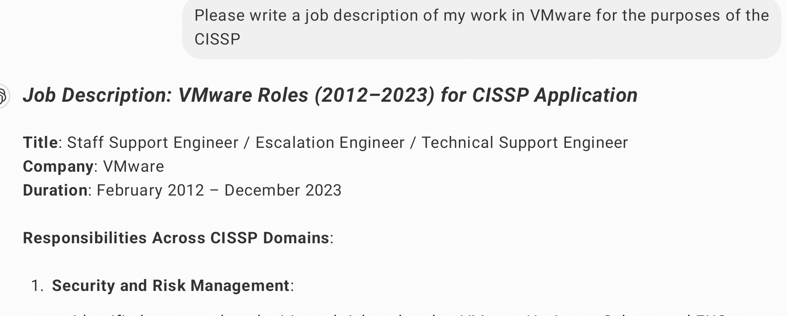
CV Breakdown for the endorsement.
After you pass, you submit the endorsement application and you wait and you wait and wait.

Slide 16
What’s the takeaway?
The rules of engagement have changed with AI - you can get it to act as your professor, study buddy , career advisor.
That long term goal of yours that seems unreachable before is not . Time to think about it again for 2025
If you have an interest in studying for the CISSP in 2025, don't be shy tonight, all it takes is a few to kick off a study group together.
Happy Xmas!!

